Slide 1



Update of the
FAO/WOAH/AU-IBAR/ILRI
Regional strategy for the control of African swine fever in Africa
Erika Chenais, Charles Bebay, Fredrick Kivaria, Madhur Dhingra

Slide 2
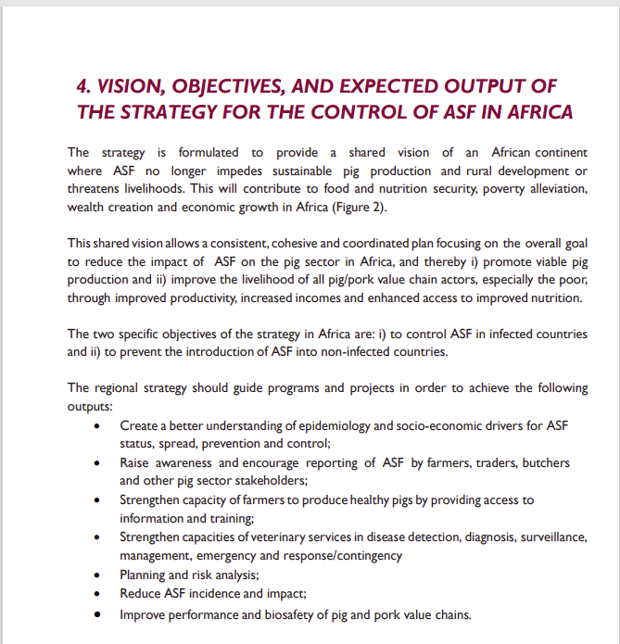
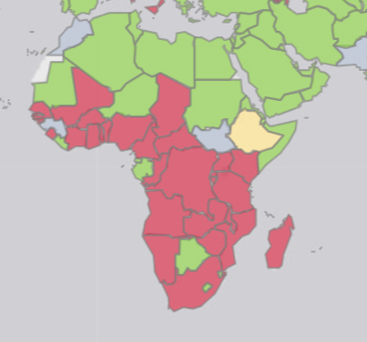
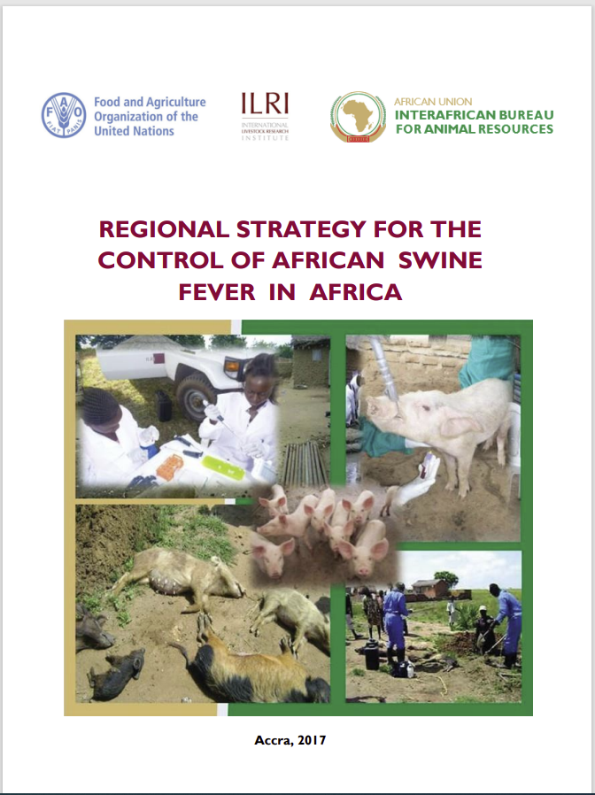
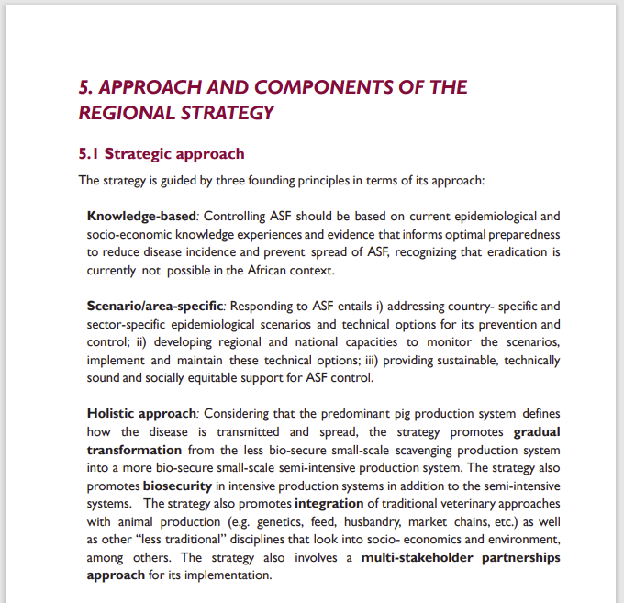
2017: A need for the establishment and implementation of a regional strategy for the prevention and control of ASF
ASF story map (windows.net)
Objective/s:
To provide a shared vision of an African continent where ASF no longer impedes sustainable pig production and rural development or threatens livelihoods

Slide 3
Implementation status of the 2017 ASF strategy outputs:
Output | Implementation status
Knowledge Creation | The strategy has been disseminated to all MSs in Africa Uploaded on AU-IBAR, FAO, ILRI website Published in Empress Bulletin Participated in GARA meetings
Knowledge Transfer | Shared some research outcomes by ILRI
Capacity Building | None
Application of Measures | None
Impact Reduction | Translated into a 4-year program
Inadequate resources is the biggest challenge in meeting the strategy objectives

Slide 4
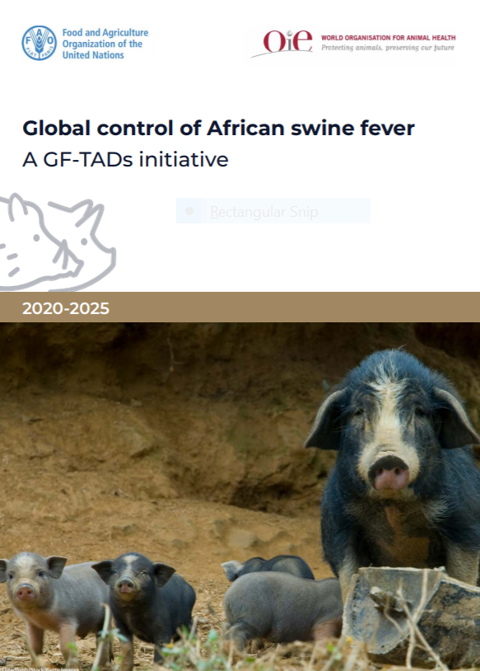
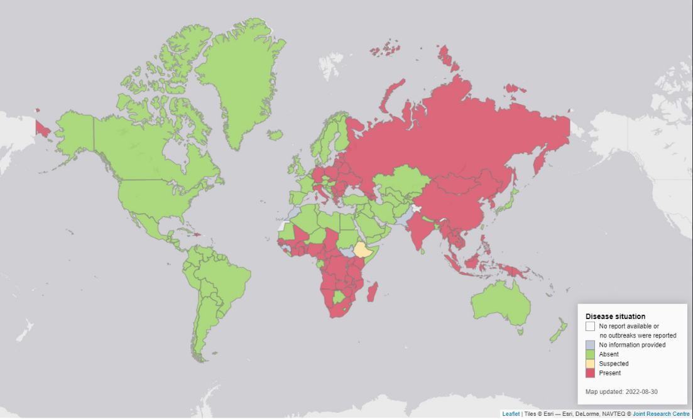
Revision of the strategy:
In view of the current knowledge and the prevailing de facto epidemic.
Align the new strategy with the Global Initiative for control of ASF and the GF TADS framework
ECTAD East Africa gave the mission to:
Perform a technical review of the 2107 strategy
  litterature review
  current ASF status in Africa
  ASF epi, control, impact in Africa
  ensure relevance to the current ASF situation
Identify strategic issues and actions that need to be addressed
First Regional Strategy from 2017

Slide 5
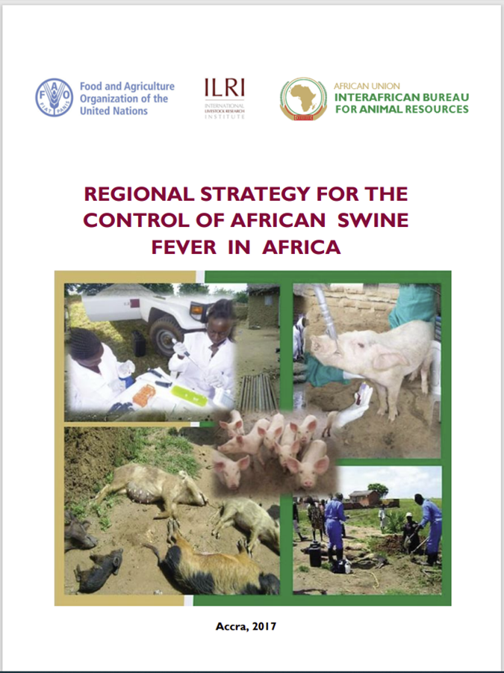
Background
Why the revision?
  Updating the strategy in view of the current knowledge and the prevailing de facto epidemic
  Align to the GF-TADs initiative - global control of ASF
Implemented under the:
  DTRA – funded project …
  Global Framework for Progressive Control of TADs – (GCP/GLO/074/USA) –
  East Africa Component – ASF
Notes:
The GF-TADs initiative for the Global control of ASF aims to tackle strategic challenges, promote partnerships, strengthen prevention and preparedness measures, and minimise the adverse impacts of ASF.
The project aims at supporting the GF-TADs initiative to control ASF at global, regional and country level

Slide 6
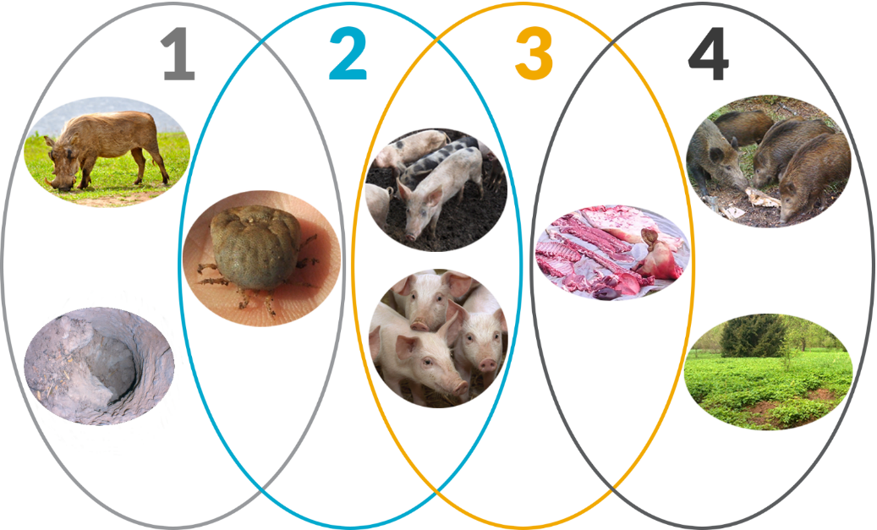
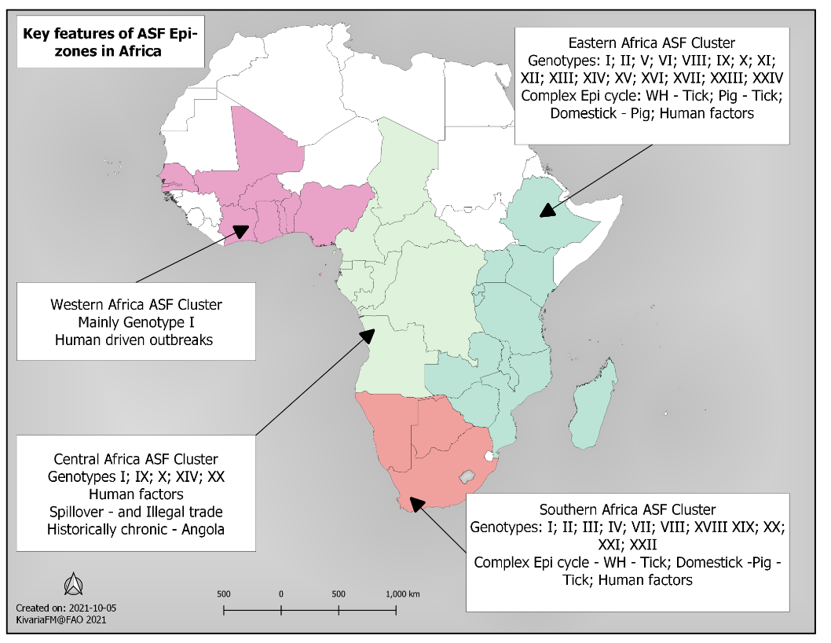
Is outcome focused
Is based on the known epidemiologic dynamics of ASF in Africa
  presence of three epidemiological cycles
  Includes and considers contextual aspects of ASF in Africa:
  small-scale subsistence farming
  resource limitations
  -inadequate reporting
  -low capacity to prevent, detect, respond and react (operational readiness)
  Puts focus on the entire value chains
  -multiple factors and actors, differently influencing disease outcomes and impact
The revised strategy:

Slide 7

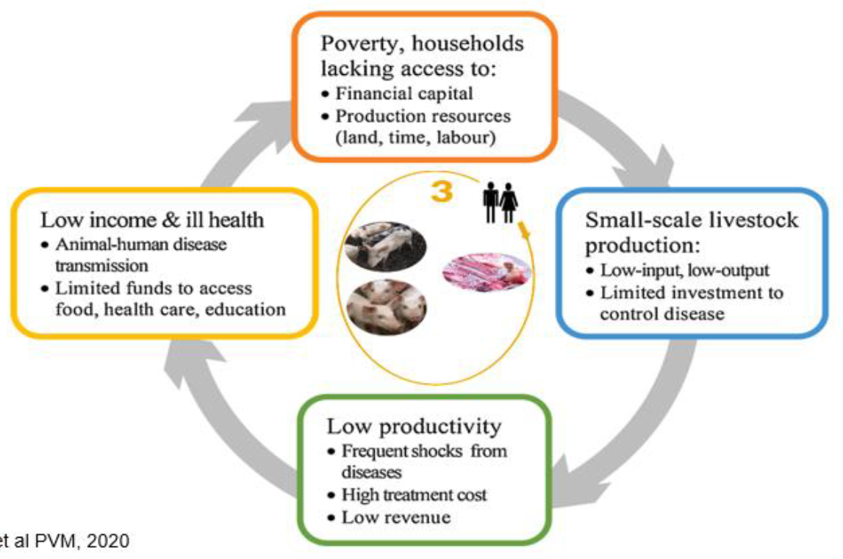
Shifting focus
From knowledge and technical solutions to actions and contexts
From people to structures
From blaming farmers or value chain actors for the decisions they make to trying to understand their rationale and adapt actions to their priorities

Slide 8

The thinking
Current epi-status and knowledge
Several epidemiological cycles
Local context
Inherent institutional challenges
  Subsistence farming
  Inadequate reporting
  Low capacity to prevent, detect, respond and react (operational readiness)
Cross-cutting issues
Multiple factors and actors, differently influencing disease outcomes across the spectra/VC

Slide 9

Overall objective: reduce the occurrence and impact of ASF in the domestic pig sector in Africa
Specific objectives:
i) control ASF in infected countries or regions
ii) prevent the introduction of ASF into non-infected countries or regions
Rationale:
ASF impair pig production and animal welfare
Secondary negative effects on rural development and livelihoods
Sustainable pig production has the potential to contribute to income creation, empowerment of marginalised people and communities
Improved pig health reduce the use of antibiotics and the risk for antimicrobial resistance

Slide 10
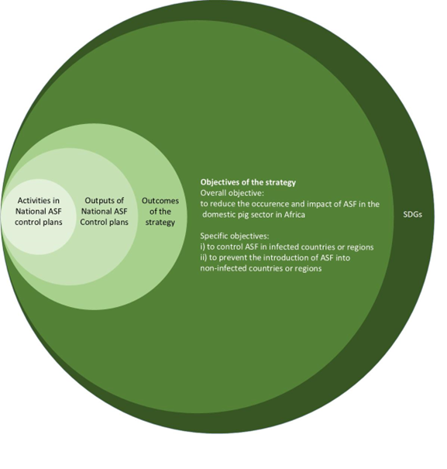
The strategy is formulated to provide a common plan for reaching the overall and specific objectives
Outcomes
better understanding of local ASF epidemiology
better understanding of social, economic and cultural factors that influence ASF prevention and control
strengthened capacities of veterinary services in disease detection, diagnosis, surveillance, emergency response and outbreak management
strengthened capacities of authorities in risk analysis, risk managment and contingency planning
improved awareness of ASF for all stakeholders in the pig value chain
improved biosecurity at all nodes in the pig value chain
strengthened capacities to produce healthy pigs and high quality, safe pork without contributing to ASF spread

Slide 11
The expected outcomes of the regional strategy are:
better understanding of local ASF epidemiology
better understanding of social, economic and cultural factors that influence ASF prevention and control
3) strengthened capacities of veterinary services in disease detection, diagnosis, surveillance, emergency response and outbreak management
4) strengthened capacities of authorities in risk analysis, risk managment and contingency planning
5) improved awareness of ASF for all stakeholders in the pig value chain
6) improved biosecurity at all nodes in the pig value chain
7) strengthened capacities to produce healthy pigs and high quality, safe pork without contributing to ASF spread

Slide 12
Notes:
depending on previous knowledge and capacities, local ASF situation and epidemiology, socio-economic context, pig production, value chain structure and needs, different activities will be necessary to reach the expected outcomes in each country. The engagement of stakeholders in the different strategic areas will likewise vary with the local context, but as previously noted, broad engagement along the value chains is paramount for achieving control of ASF.

Slide 13
Thematic area | Epidemiological knowledge | Institutional capacity Disease detection and surveillance Diagnosis Emergency response, outbreak management, contingency planning including risk analyses and management | Prevention and control Biosecurity Control measures | Sustainable pig production
Outcome | 1) better understanding of local ASF epidemiology; 2) better understanding of social, economic and cultural factors that influence ASF prevention and control. | 3) strengthened capacities of veterinary services in disease detection, diagnosis, surveillance, outbreak management and emergency response; 4) strengthened capacities of authorities in risk analysis, risk managment and contingency planning. | 5) improved awareness of ASF for all stakeholders in the pig value chain; 6) improved biosecurity at all nodes in the pig value chain. | 7) strengthened capacities to produce healthy pigs and high quality, safe pork without contributing to ASF spread.

Slide 14
Action plan
a risk and evidence-based plan for gradual and steady progress towards achieving the expected outcomes and objectives
One size does not fit all - each country needs to customize their own National ASF control plan.
Depending on the local situation:
structure of the pig sector and the value chains
urban and rural poverty levels
social and cultural contexts
available funding (outCosT)
ASF status in the country:
knowledge about ASF occurrence (unknown, sylvatic/domestic cycle regional variations, endemic or free)
existence of a prior control strategy
laboratory and veterinary sector capacities
the countries’ particular goal in addressing ASF (compartmentalisation, control or living with endemic disease status)

Slide 15
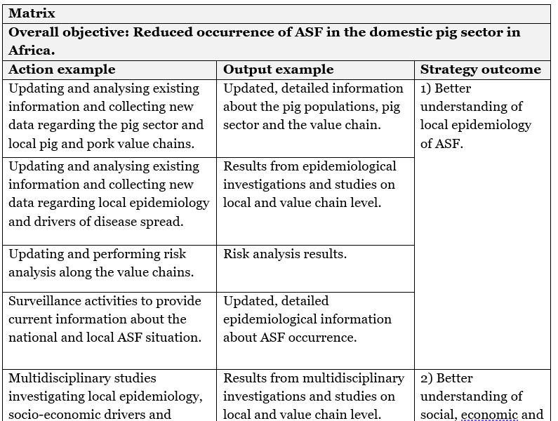
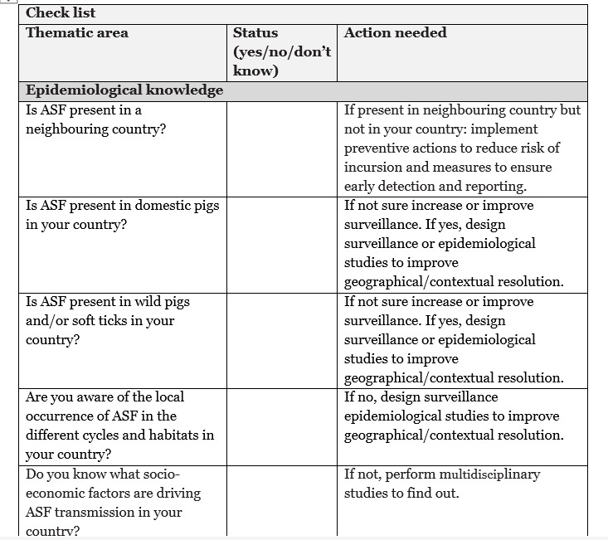
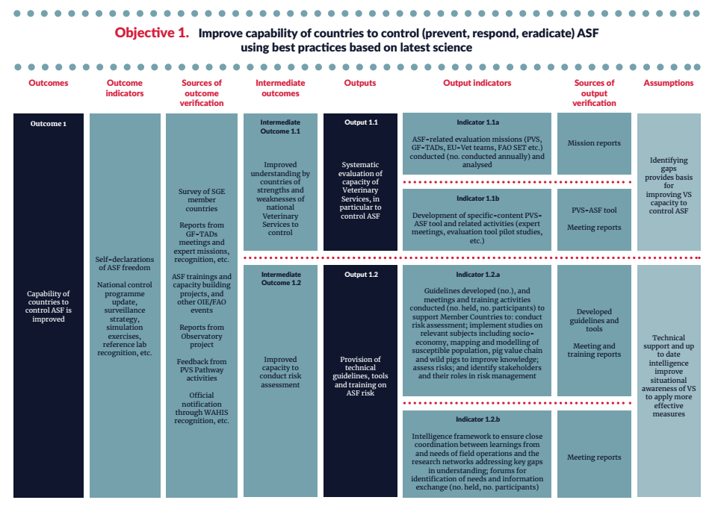
How?
A matrix with examples of actions and outputs in the National ASF control plans are linked to the expected outcomes and the overall objective of the strategy.
A non-exclusive check list for information, knowledge, capacities, specific documents, routines and plans needed to construct the National ASF control plans
No quantifications or indicators of the outputs are given, the baseline and indicators will vary between countries. The GFTADS initiative logframe can be used for this

Slide 17
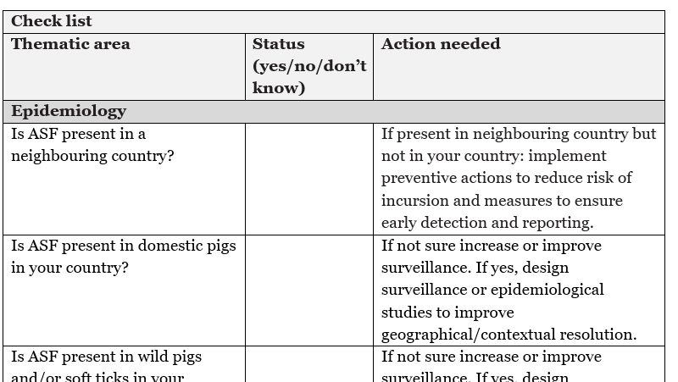

Slide 18

Work in progress
Regional validation meeting with the SGE for ASF in Africa planned to March 21-23, 2023
  SGE members,
  ASF-TWG members,
  Some CVOs
erika.chenais@sva.se
fredrick.kivaria@fao.org

Slide 19
Summary
The regional strategy for the control of ASF:
Supports the Global Framework for the Progressive Control of Transboundary Animal Diseases (GF TADs) recent initiative for Global control of ASF.
Recognizes that priorities and motivations will vary across countries and regions and acknowledges that the most effective approach to achieve the outcomes therefore will differ between countries.
Suggests that to improve control an evidence-based, participatory value chain approach adapted to local contexts is necessary.
This entails enhanced collaboration and partnership along the value chain including farmers, consumers, veterinary and animal production services, researchers, governments, civil society and development partners, and taking into account the need for policies to be pro-poor and to ensure equal inclusion of all people.

Slide 20
Thank you for listening and thanks to:
The technical expert group
SGE for ASF in Africa
ECTAD East Africa
FAO Kenya
Global pool of expertise on ASF DTRA

